Slide 1
IPv6 in Germany- update RIPE 62
Constanze Bürger
Bundesministerium des Innern
Notes:
1

Slide 2
What did we do …
IPv6 Working Group
Colleagues from federation, states and municipalities
Bundles know-how from all user levels
Worked out proposals for the organization, address management and recommendations for technical implementation
http://www.rarewallpapers.com/lego-workers.html
Notes:
2

Slide 3
Decisions - Organisation
Council of federation, countries and municipalities 3. März 2011
Responsibilities :
Federal Mininstry of the Interior and Federal Office of Administration take over the role „de.government“
/32 blocks are self administrated in Sub Local Internet Registries (Sub LIR)
Sub LIRs are for instance data centers, states, public network providers,…
Notes:
3

Slide 4
Decisions - Address Concept
Splits the /26 in 64 /32 bloks
Aim: well structured networks
Notes:
4

Slide 5
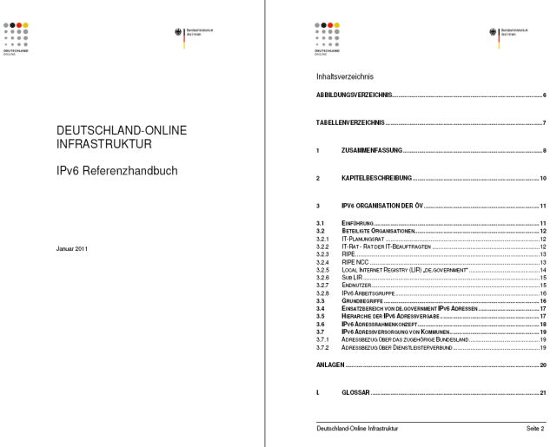
Reference Handbook
Address concept - templates
Roles
Organisation
Processes
Technic recommandations
Security
Policies
Checklists
etc

Slide 6
Application for a Pilot from EU COM
“ICT Programm for Innovative
government and public services“
Objective 4.3: Piloting IPv6 upgrade
for eGovernment services in Europe
Complementary experiments
Participation of different MS
Start from a baseline project
Exploit synergies between experiments
Strong focus on dissemination
Spain
Slovenia
Turkey
Germany
Netherlands
Belgium
Greece
Luxembourg
Czech Rep
Coordination: Germany
Notes:
6

Slide 7
Next Steps
Allocation of the \26
First IPv6 pilots
Buildup SubLIRs
Announced the first de.government-addresses
Approval IPv6 for the network DOI
operative LIR de.government finished
Start EU-Pilot
Schedule
Q4/09
Q1/10
Q2/11
Q3/11
Q4/11
Q4/11
Q1/12
Notes:
7

Slide 8
Thank you for your attention! Constanze.buerger@bmi.bund.de
Notes:
8

