Slide 1
Contractual Relationship Requirements for End Users
Implementation Update: Policy Proposal 2007-01

Slide 2
Policy Background
“The intention of this policy document is to ensure that the RIPE NCC (…) can confirm that the End User exists, continues to exist and that they continue to fulfill their obligations to comply with the original assignment conditions.”
Phase One (new assignments):
- Implemented 3 March 2009
- 10,372 independent Internet number resources assigned under the new policy since then

Slide 3
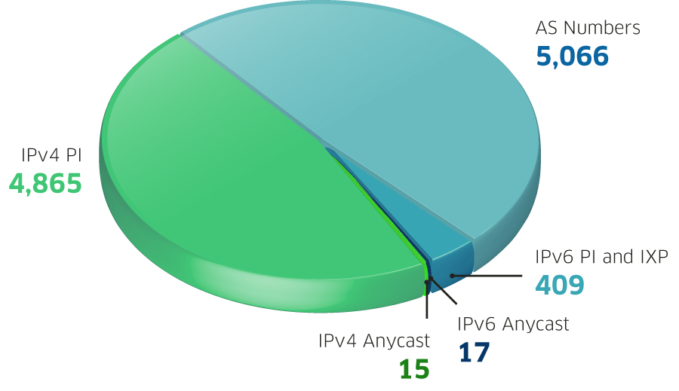
Resources Assigned Under the New Policy

Slide 4
Phase Two - Existing Assignments
“(…) a contractual relationship must be put in place for End Users of provider independent number resources which were previously assigned (…)”
Amount of resources: 26,940
Phase Two started in May 2009, finished on 15 March 2011

Slide 5
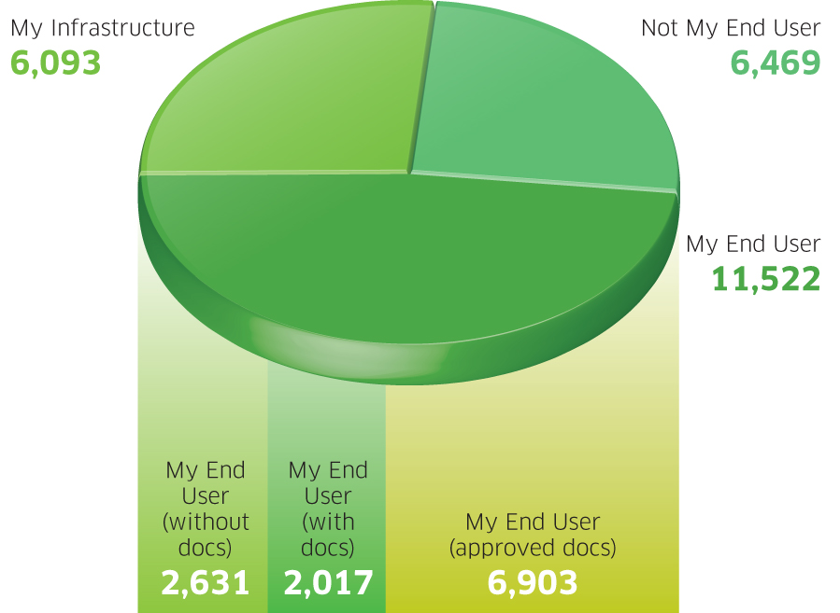
Phase Two Results

Slide 6
Phase Three – “Orphaned Assignments”
Directly contacting End Users who have not entered a contract with a sponsoring LIR or the RIPE NCC
Started 15 March 2011
End Users are asked to fill in a feedback form; RIPE NCC to follow up based on the End User feedback
Independent Internet number resources listed in closed registries are also included in Phase 3 (approx. 6,800)

Slide 7
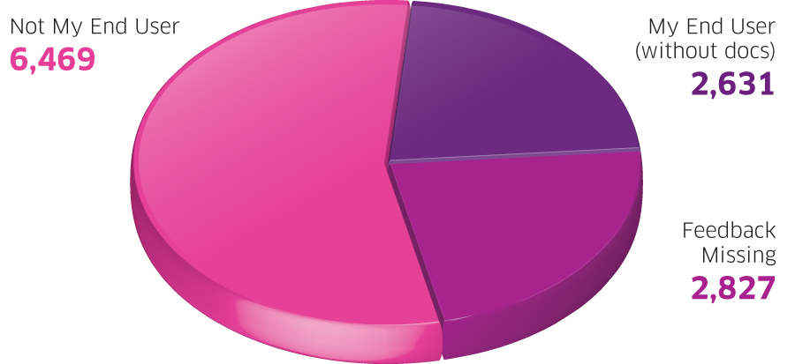
Resources to be Considered in Phase Three

Slide 8
Phase Three – Contact End Users
“Registration data (range, contact information, status, etc.) must be correct at all times (i.e., they have to be maintained).”
Contact based on registration data in the RIPE Database, using different levels of contact details
Contact method: by email

Slide 9
Phase Three - Process
Contacting End User in batches, prioritised by resource visibility in global routing table
Resource visibility: current, recent (< 12 months), old (> 12 months)
End Users will be directed to an online form to provide feedback regarding resource usage, holdership, etc.
Monitoring activity on online forms and keeping logs
Manual follow-up by the RIPE NCC

Slide 10
Phase Three – Resource De-registration
Three months after initially contacting the End User, the de-registration procedure will start if there is no response from the End User
No contract three months after response → de-registration procedure starts
For further questions, remarks or suggestions, contact us:
<enduser-contract@ripe.net>

Slide 11
RIPE NCC Maintainer
“The RIPE NCC has historically assigned provider independent resources ...”
AS Numbers were not maintained
All independent Internet number resource database objects will have:
mnt-by: RIPE-NCC-END-MNT

Slide 12
Questions?

