Slide 1
Update from the RIPE NCC
Axel Pawlik
Managing Director

Slide 2
We are here to serve you
Secretariat for RIPE Community
Founded in 1992
Teenager on verge of adulthood
Activities to support coordination of Internet operations
Service region Europe, Middle East, Parts of Central Asia

Slide 3
Activities (on a neutral & impartial platform)
Support for RIPE
Policy development Process
Regional Internet Registry
Operations of Root Nameserver
Operations of RIPE Database
Internet Measurements
Training
Outreach
ENUM Tier 0 Registry
…

Slide 4
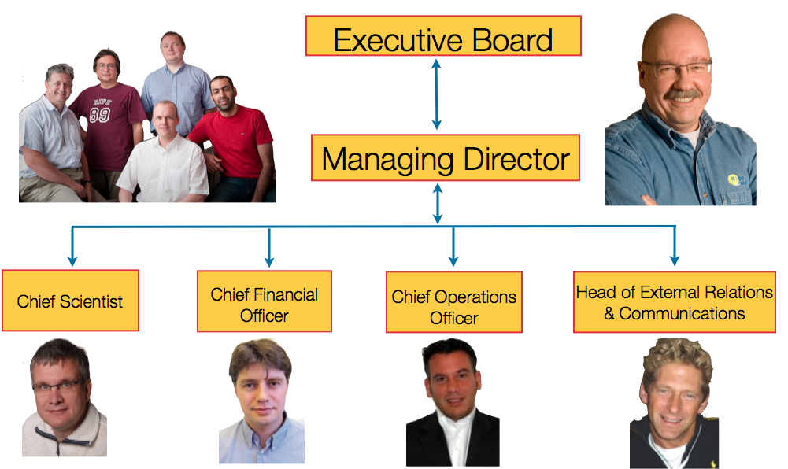
Key People

Slide 5
Future and Strategy
IPv4 depletion as Discontinuity
How will RIPE NCC be affected?
Developing Strategies for the Future
Focusing on Usefulness for Members and Community
“Back to the Roots”
Focus on…
Strong Registry
Strong Community

Slide 6
Three Strategic Pillars
Resource Lifecycle Management
Maintaining the Number Registry
Reliable Source of Data
Develop, use and publish the wealth of data available
Developing the Role of the RIPE NCC
Engage Stakeholders in Internet Governance
Prove Utility of RIPE NCC to Public Policy Makers
Intensify work with RIPE Community to understand Needs

Slide 7
Current Developments
Service to Members
Relevance? / Quality? / Member Communication!
Community Engagement
RIPE Labs
Regional Meetings (MENOG, ENOG, Dubrovnik)
Call for RIPE Meetings from (too) many corners
RIPE Days…
Working with WG Chairmen
Membership Survey to be launched on Friday
Your participation is crucial

Slide 8
The Future
Allocations ↘, Registrations ↗
Services for “Community”
Community of Internet Operators
The Internet at Large
Welcome home holders of legacy space
All users of RIPE NCC services should be members
Fair distribution of cost
Reviewing Charging Scheme, must be…
Fair
Predictable
Ensuring Stability

Slide 9
Roadmap “New Charging Scheme”
Discussions with Executive Board
Indicate ideas to Members / General Meeting
Go to drawing table
Develop scenarios
Write up strawman & publish to members
Collect feedback from discussions
Review proposal with Executive Board
Finalise documents for General Meeting @ RIPE 63

Slide 10
Questions?

Slide 11
Member Services
RIPE 62
Andrew de la Haije
COO

Slide 12
Three focus points
Transparency and Procedures
Evolution of services
Improved member interaction

Slide 13
Transparency and Procedures

Slide 14
Transparency and Procedures
Enhance transparency
Driver
Not always as clear as we could be
Actions
External Impact Analysis
Seeking community guidance on unclarities in policy interpretations: Address Policy WG and mailing list
Publish Evaluation procedures: IPv4 online http://www.ripe.net/lir-services/resource-management/contact/ipv4-evaluation-procedures
IPv6 and ASN upcoming if you find this useful

Slide 15
Transparency and Procedures (2)
Registration Services ticket mechanism change: all (IPv4) requests in one ticket queue, new and ongoing requests
request
robot
queue
13:45:01 12.11.2010
17:36:57 14.11.2010
Time stamp
IPRA
Questions?
approval

Slide 16
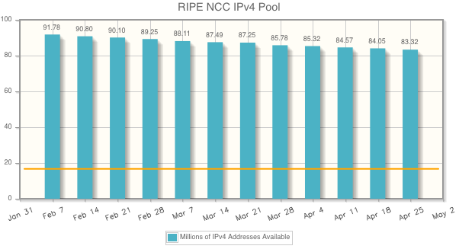
Transparency and Procedures (3)
Graph of RIPE NCC available IPv4 address space pool http://www.ripe.net/internet-coordination/ipv4-exhaustion/ipv4-available-pool-graph

Slide 17
Evolution of Services

Slide 18
Evolution of Services
RIPE registry data quality
Driver
Maintain an accurate and complete registry
Surveyed membership, 80% of respondents support service
Actions
Confirmation of validity of LIR data
LIR Self-Audit (through LIR Portal)
Inetnum, route, rDNS and person objects
Confirmation visible in RIPE DB object

Slide 19
Evolution of Services (2)
RIPE NCC Audit
Confirmation of validity of LIR data by RIPE NCC
LIR contacts, organisation and allocation details
Replace ‘additional allocation audit’
50% of membership audited per year
Confirmation visible in RIPE DB object

Slide 20
Evolution of Services (3)
Resource transfer listing service
Driver
Maintain an accurate and complete registry
Facilitate resource transfers for members
Action
Provide Platform where ‘lister’ and ‘needer’ can meet
Member only service
RIPE NCC confirming
Member
Registry
Policy

Slide 21
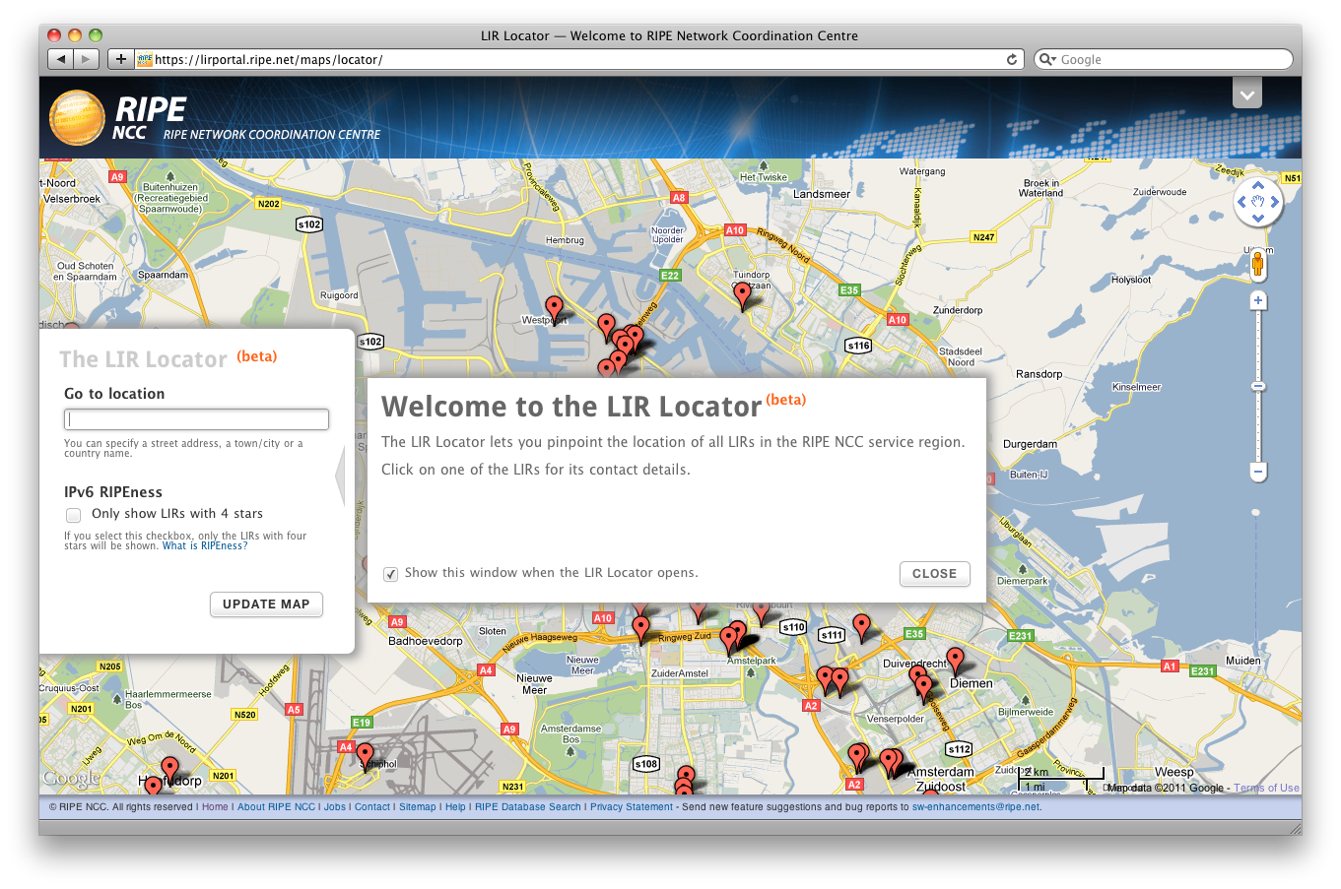
Evolution of Services (4)
- Geolocation

Slide 22
The Problem
No mechanism to link IP addresses to a location
Establishing this link is difficult and error prone:
Finding out a postal address is hard
Translating the address to a geolocation is hard
The result:
Location based services may be mismatched
Access to certain services could be blocked
Content could be delivered in the wrong language

Slide 23
Solution
You are the holder of the IP address block
You are the authority on where the block is used
You know what services are offered
You know the preferred language
The RIPE NCC will provide the gateway
through the RIPE Database

Slide 24
Everybody Benefits
End Users
Receive content in the desired language
and related to their location
LIRs
Full control over location based services
Less End User complaints
Content Providers
Easier to address their target audience

Slide 25
The Way Forward
Adding location data is always optional!
Your privacy is guaranteed
Linking of individual IPs to a location never possible
Resolution of data is user defined
You are in control of the granularity
We are actively looking for feedback and ideas
Check RIPE Labs for updates
Cooperation with Google, MaxMind, IP2Location
Can you introduce us to other partners? Let us know!

Slide 26
Working with 3rd Parties
Cooperation with Google, MaxMind, IP2Location
If you opt to add location data to your RIPE Database objects, it will be added to their data sets
Can you introduce us to other partners?
Let us know!

Slide 27
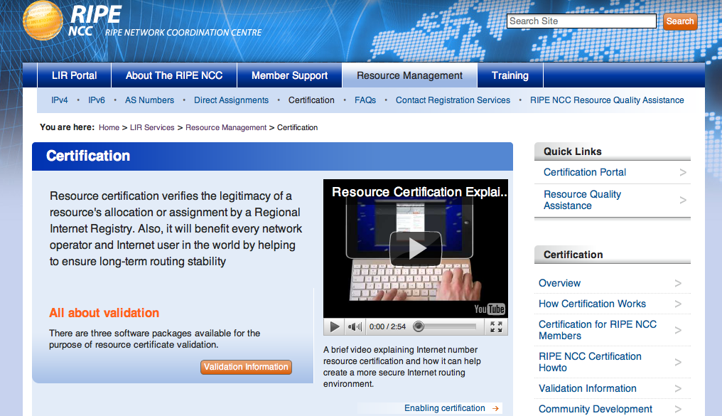
Evolution of Services (5)
Certification
Enhancement of Registration information
Launched 1 January 2011
430 members certified their address space

Slide 28
Member Interaction

Slide 29
Member Interaction
Network Coordination Services
http://www.ripe.net/lir-services/resource-management/ripe-ncc-resource-quality-assistance
Driver
Regular requests for support on filtering issues
Issues with getting in contact with the right contacts
Action
Assist by coordination
Information and guidance on filtering and tools to identify who and why
If needed put both parties into contact and coordinate

Slide 30
Member Interaction (2)
Proven benefit (recent case)
Small LIR: /20 allocation being filtered by large ISP based on former holder of address space
RS contacted large ISP, giving neutral information/contact information
Large ISP investigated and fixed. Resolved in 3 working days

Slide 31
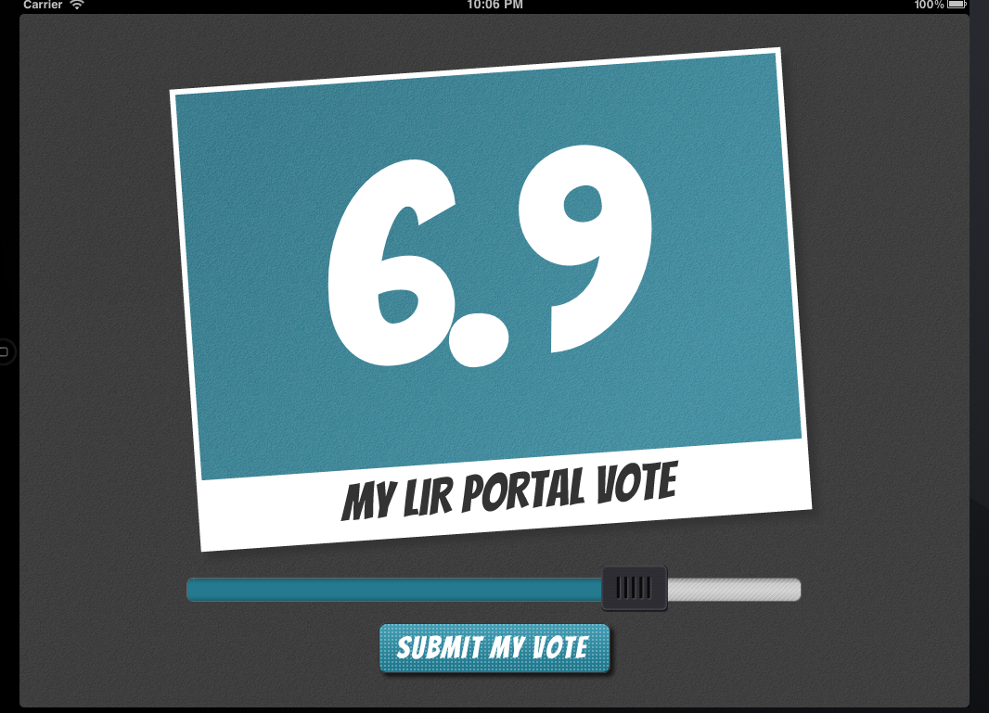
Member Interaction (2)
Feedback on LIR portal functionality

Slide 32
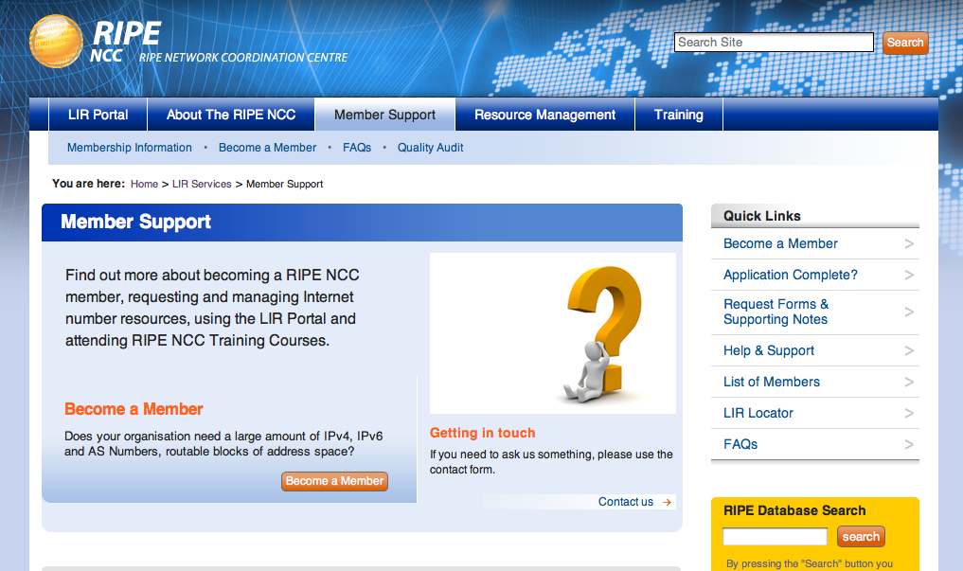
Member Interaction (3)
Pilot web-chat functionality

Slide 33
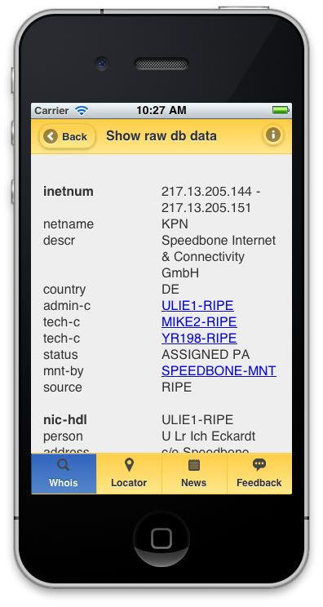
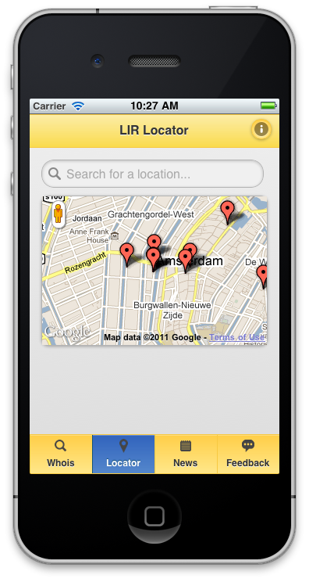
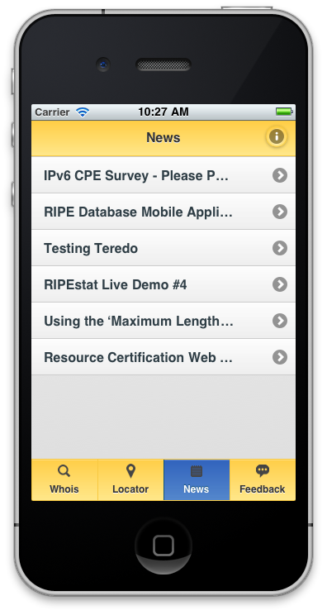
Member Interaction (3)
RIPE NCC Mobile Pilot

Slide 34
RIPE NCC Mobile Pilot
mobile.balounge.net

Slide 35
Questions?

Slide 36
Support department Update Finance, Admin, Facilities, Legal, Info Security and IT
Jochem de Ruig
Chief Financial Officer
Notes:
Fin, Admin, Facilities, Legal and IT

Slide 37
Finance & admin update 2011
Invoicing & payments 2011
Investigating additional payment tools
Set up of paypal for RIPE meetings
Audit 2010 & new auditors 2011
RIPE NCC office improvements
New access card system, “airco”/fresh air system
Continuous automation improvements
Business expense claim tool
Travel request/authorisation software replacement
37
Notes:
Improved Financial Reporting by automation by reducing FTE effort to produce financial reports

Slide 38
Legal update
Continuous work on RIPE NCC Governance docs
Transfer doc, due diligence, audits, abuse handling etc.
Legal framework for RPKI
Engagement with law enforcement and regulators
LEA event during e-crime congress in London
Council of Europe – Critical Infrastructure
Ongoing legal support
Impact analysis on policies, legal requests
38
Notes:
Legal support in all RIPE NCC activities
Legal analysis and framework of new services
Legal impact analysis on RIPE Policy proposals
Fortifying authorship rights for RIPE Policies
EC Data Protection consultation
Participation in DP discussions on the new EU legal framework
European Commission
participating in discussion on cybercrime - May 2010
Council of Europe
- Cybercrime convention & advisory group on cross border Internet
IGF participation
LE roundtable – March 2011, London
Cybercrime Working Party (CCWP)
2007-01 support with contractual requirements
Dealing with information requests by LEAs

Slide 39
IT Infrastructure & Information Security
Review of IT Infrastructure
Different perspective, aim to simplify, increase efficiency
Support for RIPE NCC services (incl RIPE mtg)
Security review of infrastructure
Network Intrusion Detection System
Information security review of internal processes
Due diligence on member enrollment
39

Slide 40
Science, Data, DNS
The Highlights.
Any Questions Welcome.
Daniel Karrenberg
Chief Scientist

Slide 41
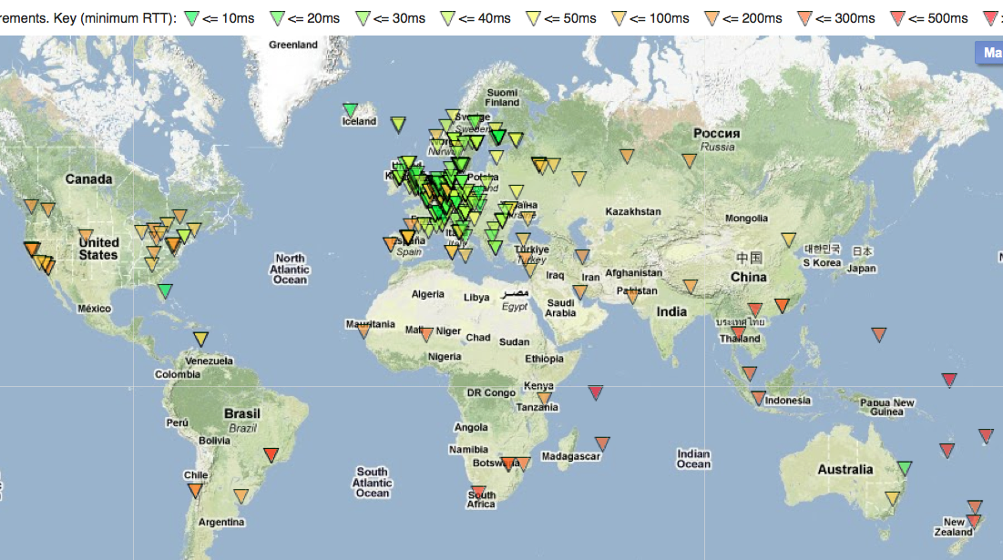
RIPE ATLAS
Active Internet Measurements from a Lot of Small Probes

Slide 42
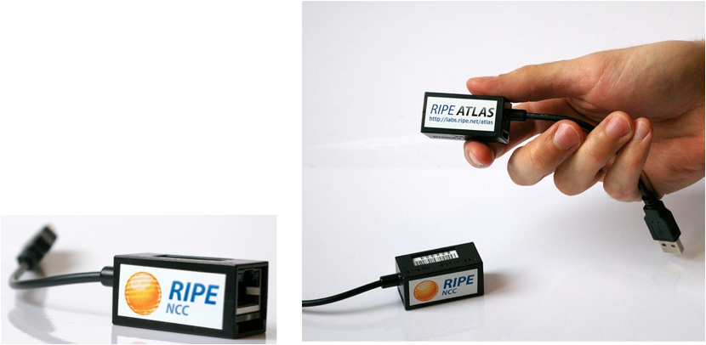
RIPE ATLAS
Launched at previous RIPE meeting (Rome)
Atlas.ripe.net
Seeking Sponsors
350+ probes deployed
Deploying 1024 more in the coming months
Aiming for good geographical and topological coverage
Deploying another 1024 from October
Details @ MAT-WG and Measurements BoF

Slide 43
RIPEstat

Slide 44
RIPEstat
You
Number Registry
(RIPE DB)
Geo-Location
(Maxmind, …)
Routing Registry
(RIPE DB)
BGP Routing
(RIS)
Active
Measuring
(TTM, ATLAS)

Slide 45
RIPEstat
Beta(!) launched this meeting: stat.ripe.net
Eventually to replace most measurement tools
Iterative Development
Public demos by teleconference every 4 weeks
Demo minutes on RIPE Labs
Demo recordings @ stat.ripe.net
Tell us what you need!
You will get the tools you deserve …
Details @ MAT-WG and Measurement BoF

Slide 46
RIPE TTM Future
TTM is an “old” service
Designed for different environment than today’s
We will evaluate current usefulness for subscribers
Then we will make a plan to evolve it
Current Straw man: integrate into RIPE Atlas
We will talk to all subscribers

Slide 47
Questions?
Also about things I did not mention.

Slide 48
External Relations & Communications
Paul Rendek
Head of Communications and External Relations

Slide 49
Outreach Goals
From the Activity Plan 2010:
Work with a range of stakeholders from both the public and private sectors
Continue to promote the important dialogue between the technical community and governments
Relevant parties working together to understand the changing Internet landscape and to make informed decisions that guarantee the stability of the Internet

Slide 50
Why?
Internet is a multistakeholder arena - we’re not the only ones making decisions!
Governments, international organisations and law enforcement growing their influence in Internet governance
Keep Gov’ts informed so that they can make better public policy
Other stakeholders see the benefits of the open and inclusive model to cooperate with each other

Slide 51
RIPE NCC Outreach Activities
Technical communities (NOGs, NRENs, ETNO… )
Local IPv6 related events
Internet governance circus ;-)
Government, Regulators, Law Enforcement
Inter-governmental organisations (OECD, Council of Europe, ITU…)
Coordination with industry partners – RIRs, ISOC, ICANN, IETF…

Slide 52
Recent Activities
Internet governance structures
IGF continuation discussions, CSTD working group
NTIA Notice of Inquiry on future of IANA function
http://www.nro.net/news/nro-response-to-ntia
ITU IPv6 Group (April 2011)
IPv6 Roadshow hailed as a successful model for capacity building

Slide 53
How?
Meetings
RIPE Meetings, RIPE NCC Roundtable Meetings, RIPE NCC Regional Meetings (in collaboration with MENOG and ENOG, Dubrovnik)
Presence at Operator Forums
Speaking opportunities at numerous events
RIPE Labs
RIPE NCC/RIPE Website
Annual Report – published soon!

Slide 54
Survey Time!
RIPE NCC Member and Stakeholder Survey 2011
Opens from 6 May – 10 June 2011

Slide 55
Questions?

