Slide 1
DSMIP6-TLS in emergency response
and public safety teams
or
IPv6 enabled self organizing systems for emergency response environments

Slide 2
Agenda
Politics, marketing and all about EC IPv6 pilots and experiments call – 1 minute
What we really want to do – 19 minutes

Slide 3
EC CIP call
3M EUR of funding for IPv6 pilots and experiments in member states, 50% funded
5 experiments
At least 1 cross-border
Must be real IPv6 deployment, not papers and research
…otherwise I would not be standing here talking about this ☺

Slide 4
Obvious and nice IPv6 features
Seamless connectivity from targeted/affected areas across heterogeneous technologies (e.g. GPRS/UMTS, Satellite, TETRA, ruggedized COTS - WiFi) and cross border and public
Automatic network/system planning and deployment
Node and host auto configuration, self organizing and healing network features
Secure and QoS enabled transmission of data, voice and multimedia rich services supported system

Slide 5
Not so obvious IPv6 feature
Overlay network for data transport and service functionalities will be done on DSMIP6-TLS (dual stack mobile IPv6 secured with TLS)

Slide 6
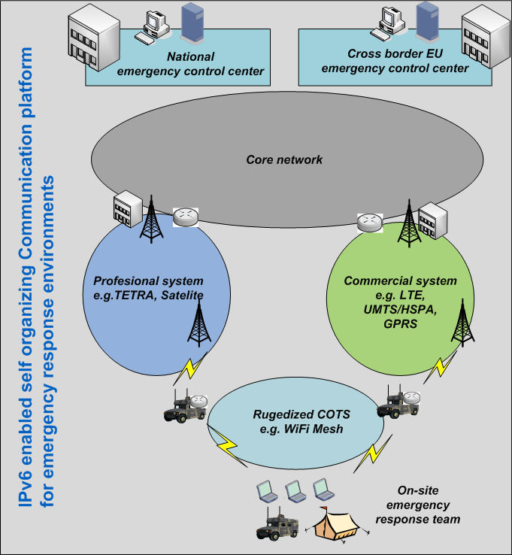
High system level view
DSMIPv6

Slide 7
DSMIP6-TLS current deployment in Slo

Slide 8
Responder always reachable…
mobile node reachability
Ability to connect to mobile node from operations center (initiation of communication in both ways is possible, not only one way)
Connect to any service directly (e.g. VOIP call to SIP client, check the temperature on fireman’s clothes sensor, engage GPS on MN, send instructions and video, etc...

Slide 9
No matter which transport…
live multimedia streaming, voice, data, and sensor data exchange from the field to the National Emergency Center
heterogeneous networks/technologies
commercial (e.g. GPRS/UMTS/HSPA)
professional (e.g. TETRA SYSTEM, Satellite)
alternative ruggedized COTS networking systems (e.g. mesh enabled wifi 802.11a/g/n)

Slide 10
Intended outcome…
Our experimental deployment proposal needs IPv6 enabled in the whole transport path. That means different parts of governmental network and infrastructure. This way we are encouraging the IPv6 implementation also in other parts of government and public infrastructure

Slide 11
Intended outcome…
Outcome of this experimental deployment can be further extended to enhance the mobility of employees of ministries and government in the future, giving them the same working environment wherever they are (e.g. mobile office).

Slide 12
Intended outcome…
The experiment will be used as showcase to derive best practices, guidelines, methodologies and toolkits for the migration from IPv4 to IPv6.

Slide 13
Go6 Q&A
Q&A

